Slide 1
Saan Ka Papunta?
(Where are you going?)
Junwoo Cheong | Julie Choi | Ariana Daly | Isadora Krsek | Robert Managad
Notes:
Robert: Project reminder, Title translation, we did Preliminary Research (includes use cases, personas, environment chart)

Slide 2
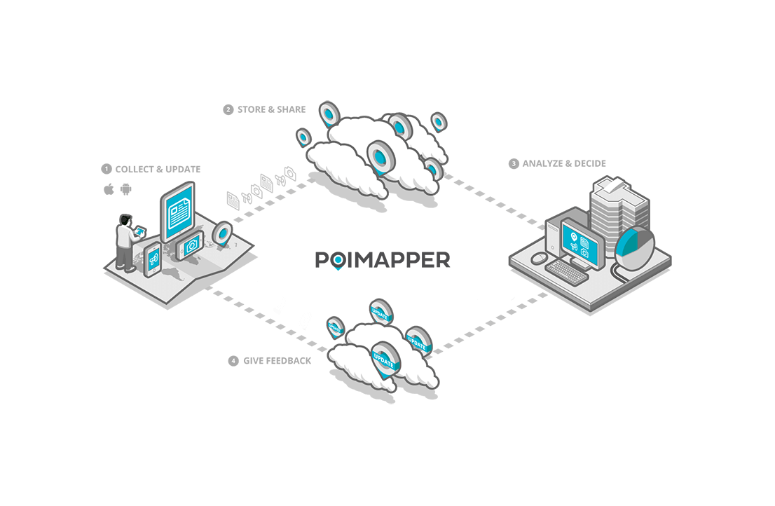
Literature Review
App Study
Collected a list of apps that used geo-spatial data like ours.
Biggest goal similarity was found in “POIMAPPER.”
Led us to some future steps:
Put more consideration into the researcher UX -- how is information organized and visualized?
Ensuring quality control of the data this app collects.
Notes:
Robert

Slide 3

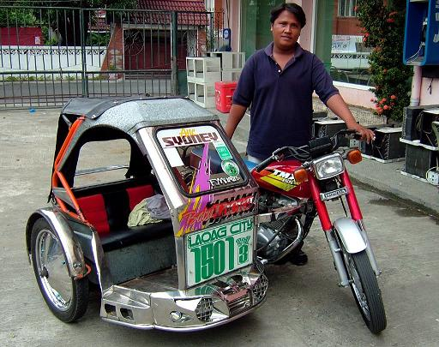
Literature Review / Prelim Interviews
Talking with Family
Discussed personal experiences (low income background) with Metro Manilla traffic.
“...have been robbed before.”
“Stuffy, sickening, but I had to make the trip to support the family.”
“Anyone who can make it better are in limousines.”
Jeepney
Tricycles
Notes:
Robert

Slide 4
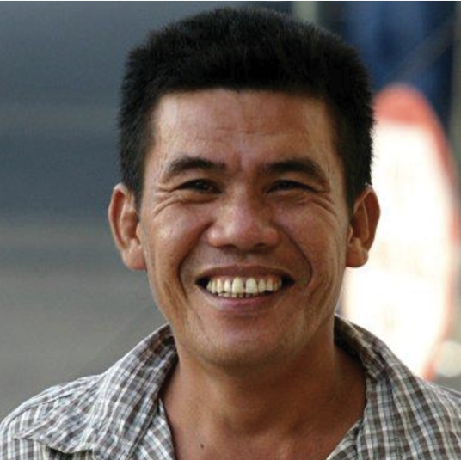
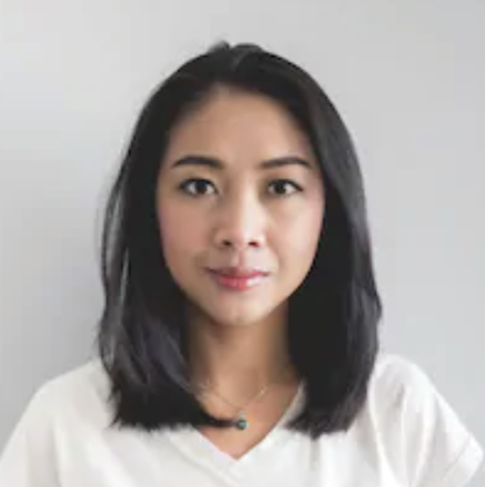
Persona Development
Persona #1
Persona #2
Angelo Ocampo (40),
Street Vendor
Nicole Mendoza (32),
Call Center Employee
Notes:
Junwoo + Julie

Slide 5
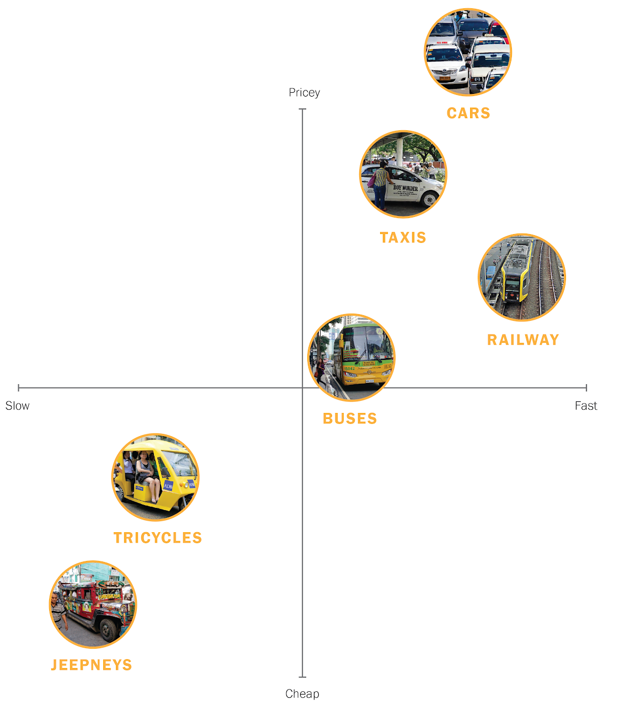
Vehicular Analysis
Emerging patterns
Correlation between most expensive and quickest forms of travel.
Gap between comfortability of bottom-left quadrant and upper right quadrant is drastic.
Comfortability and context -- we don’t want to add stress to the lives of our users.
Notes:
Robert

Slide 6
Use Cases
Use Case #1
Use Case #2
Submitting a Report
Receiving a notification/message
Use Case #3
Use Case #4
Recalling past frustrations
Researcher sending messages/comments
Notes:
Ari

Slide 7
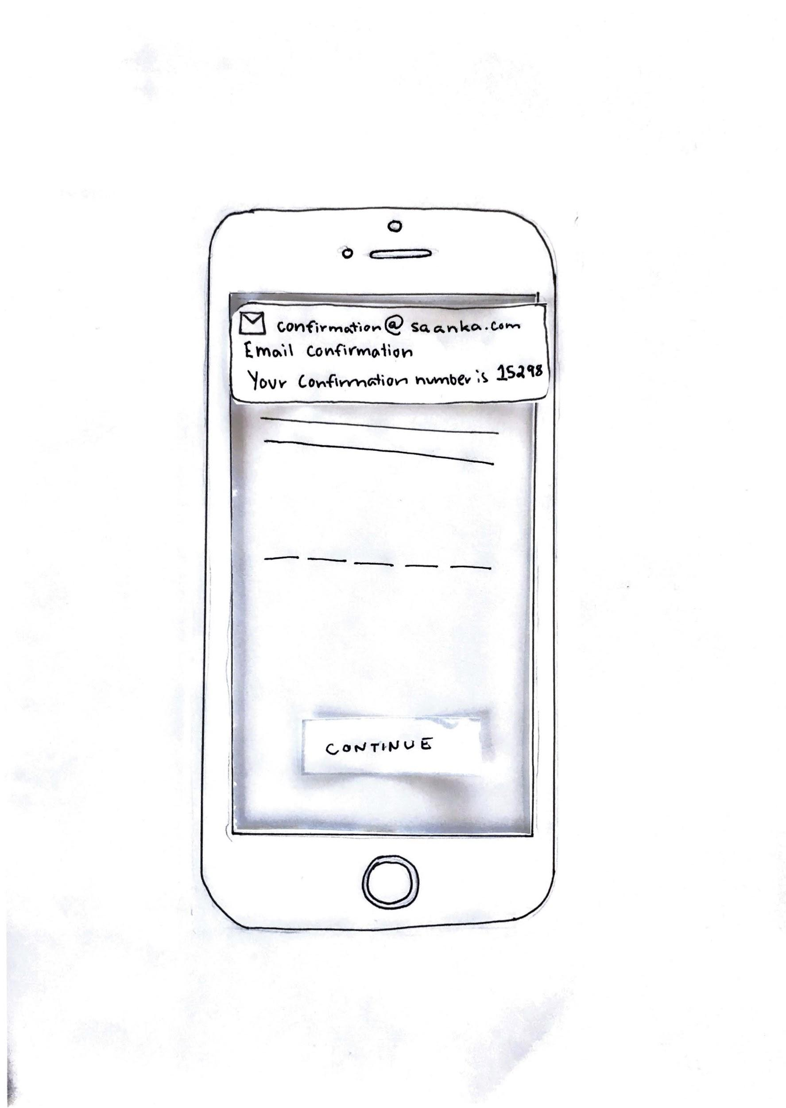
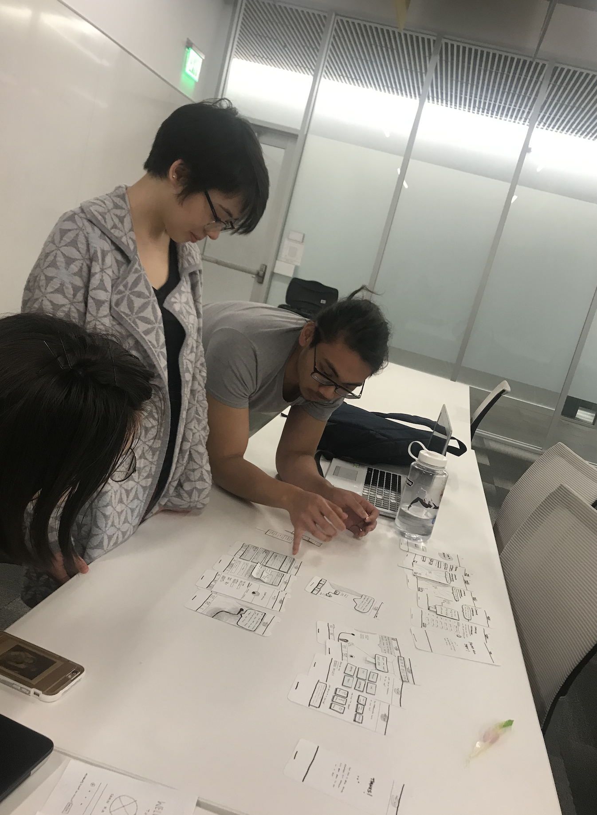
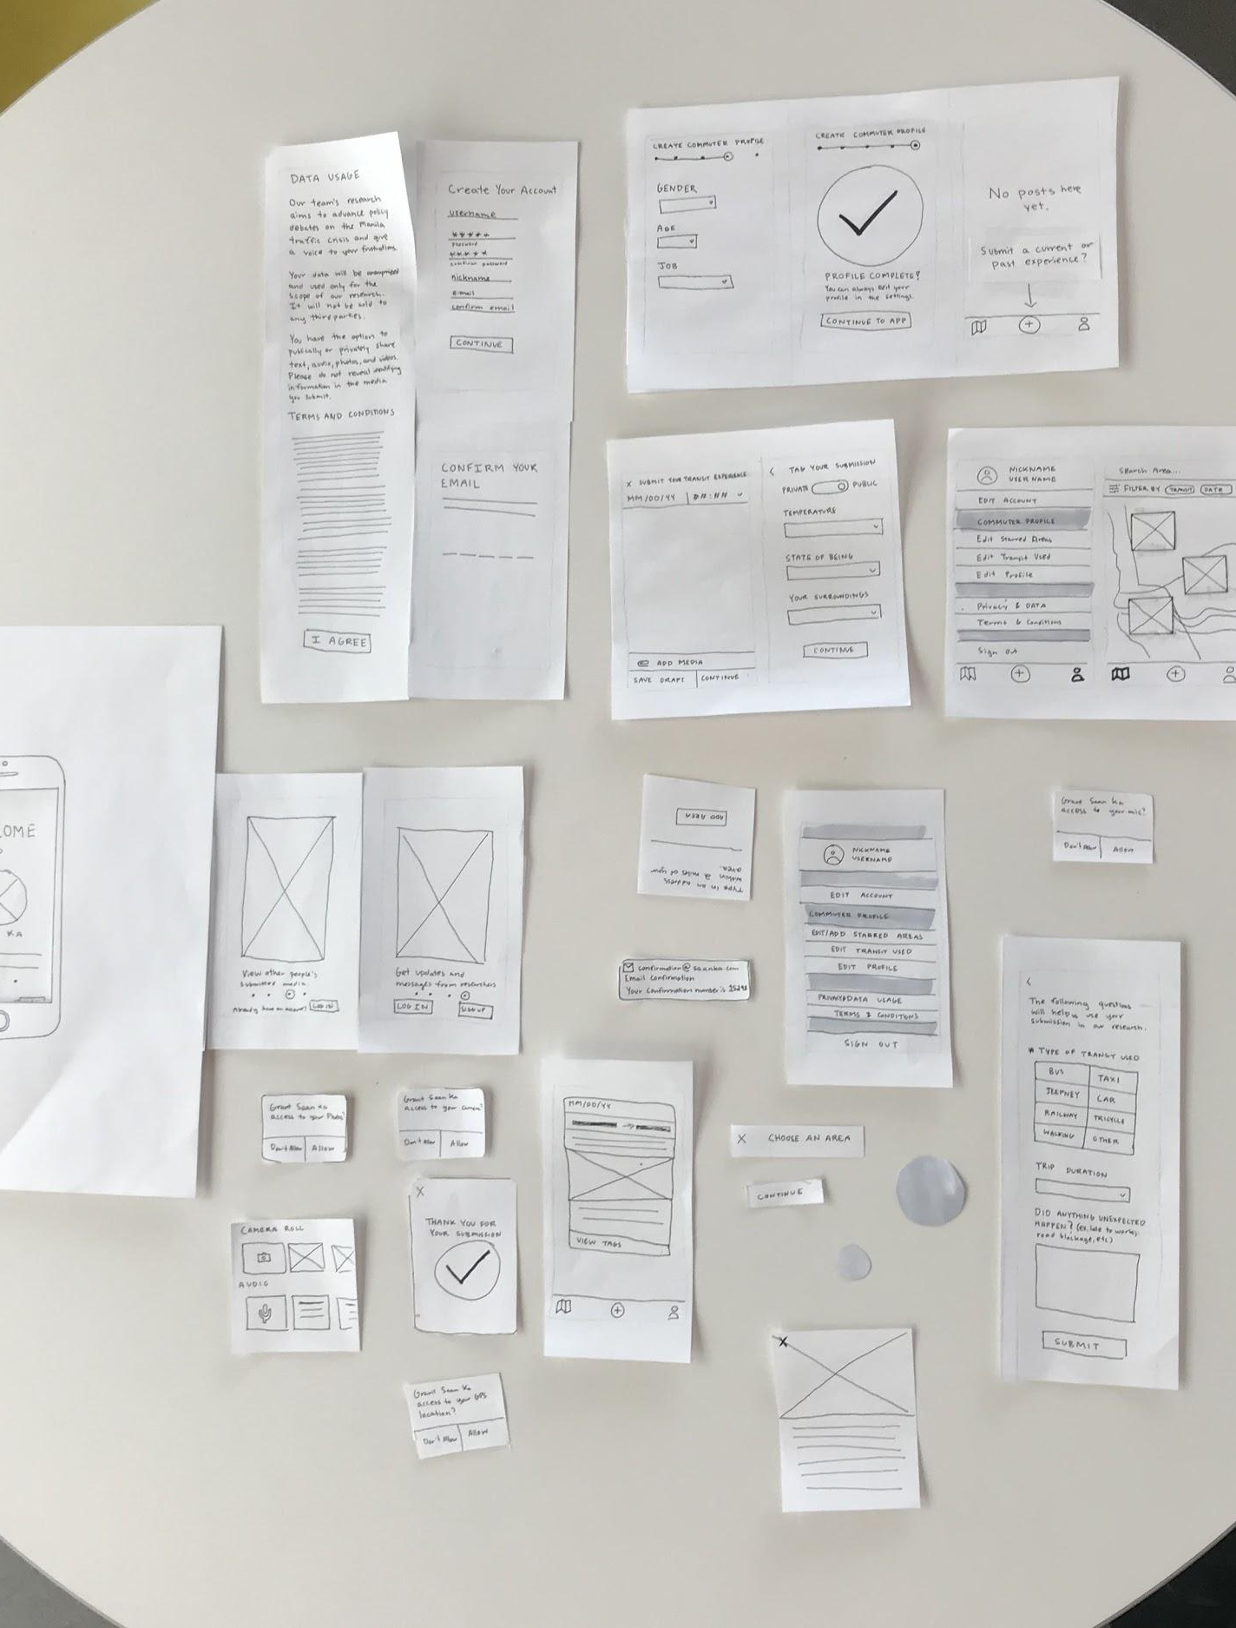
Paper Prototyping
Notes:
Ari

Slide 8
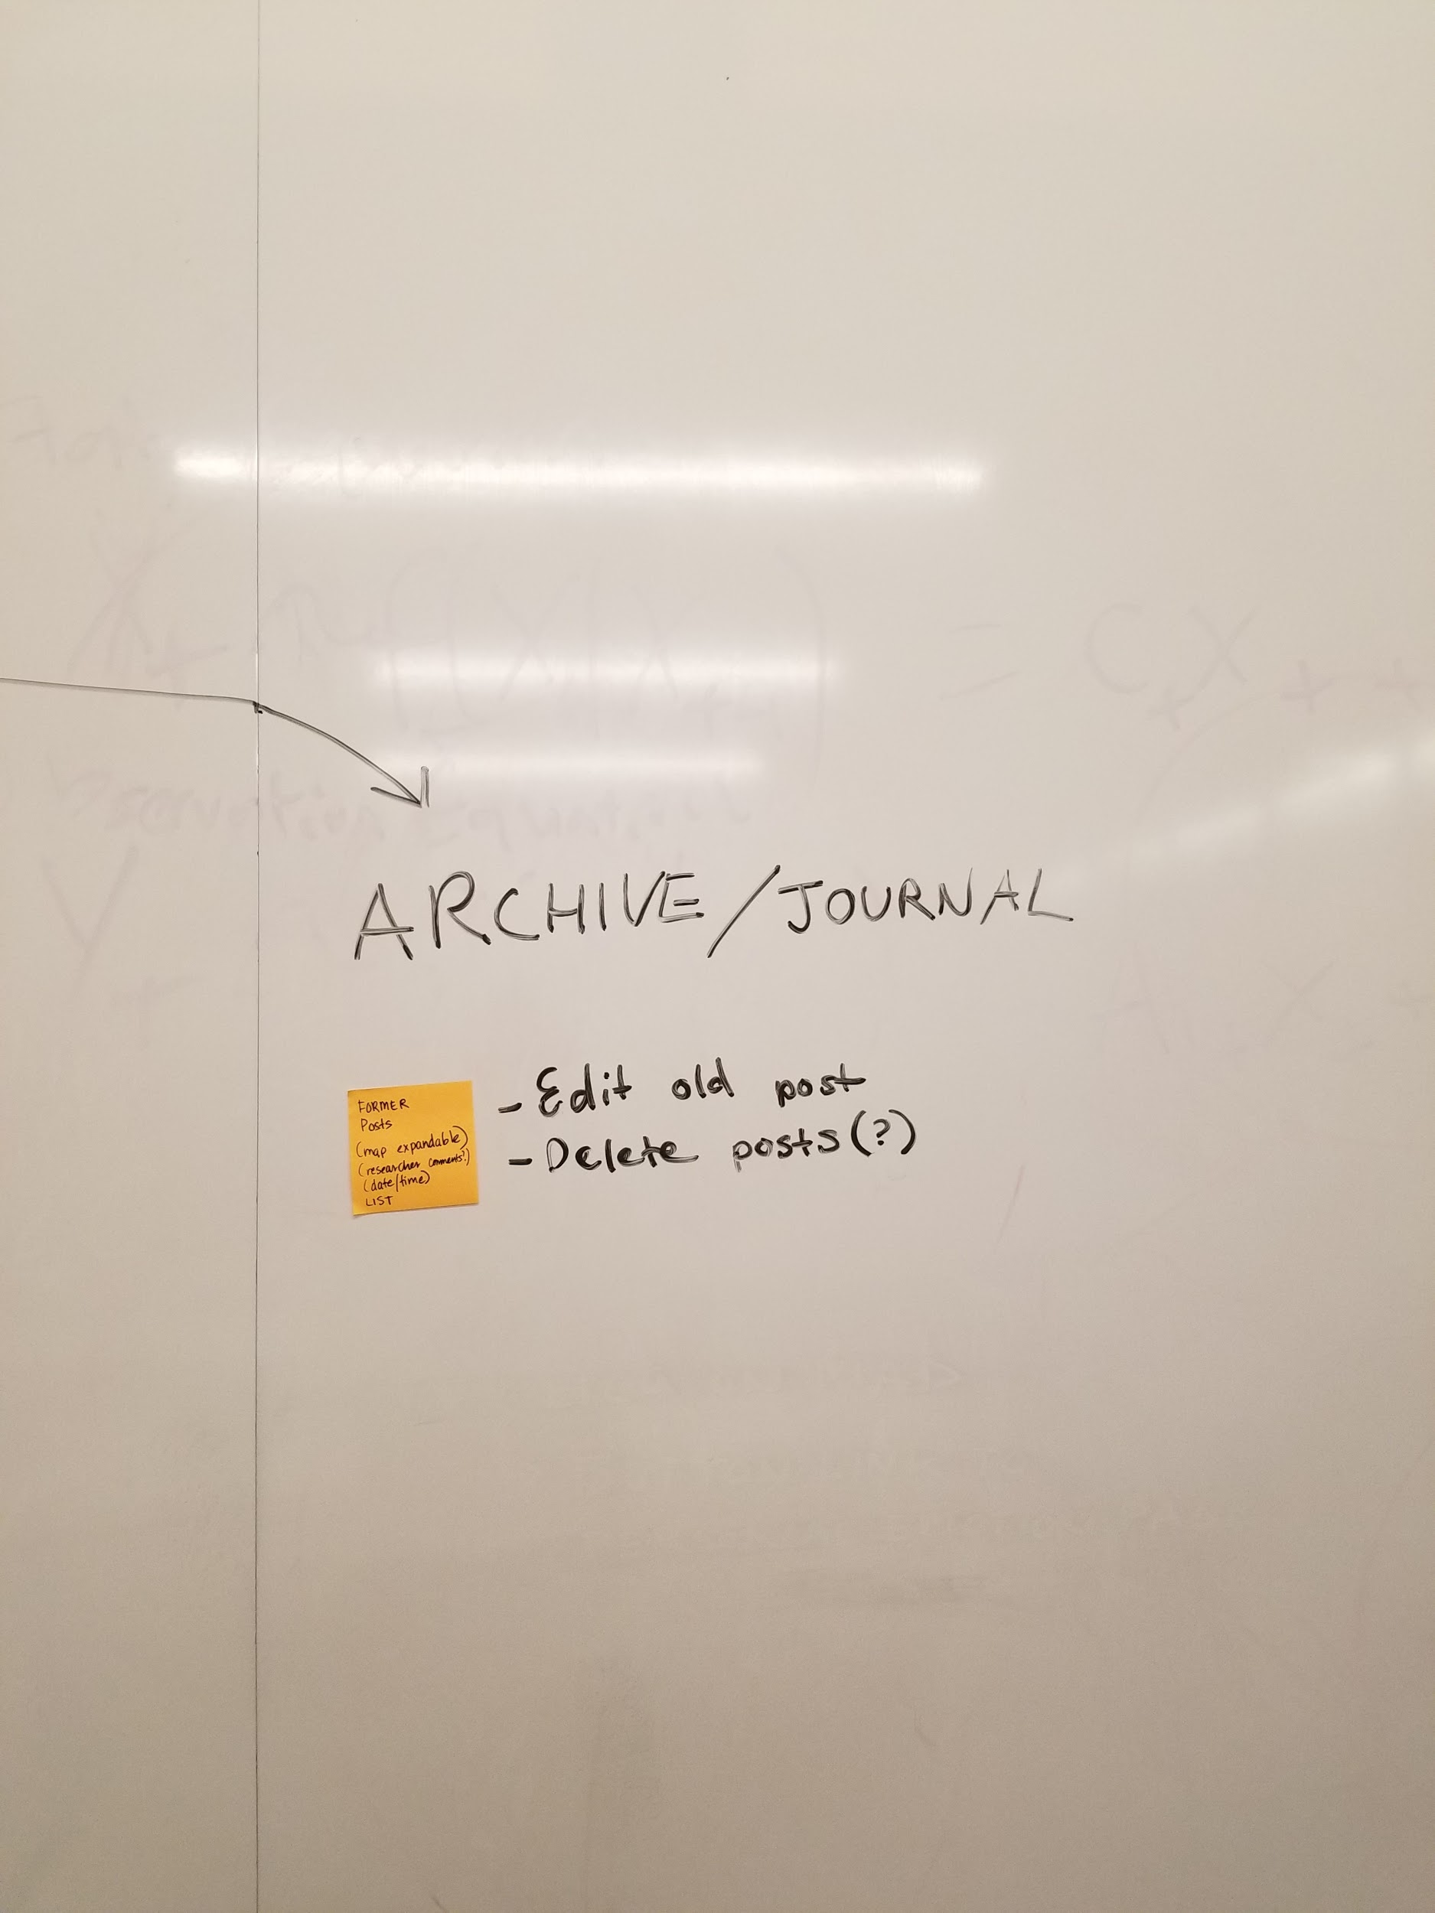
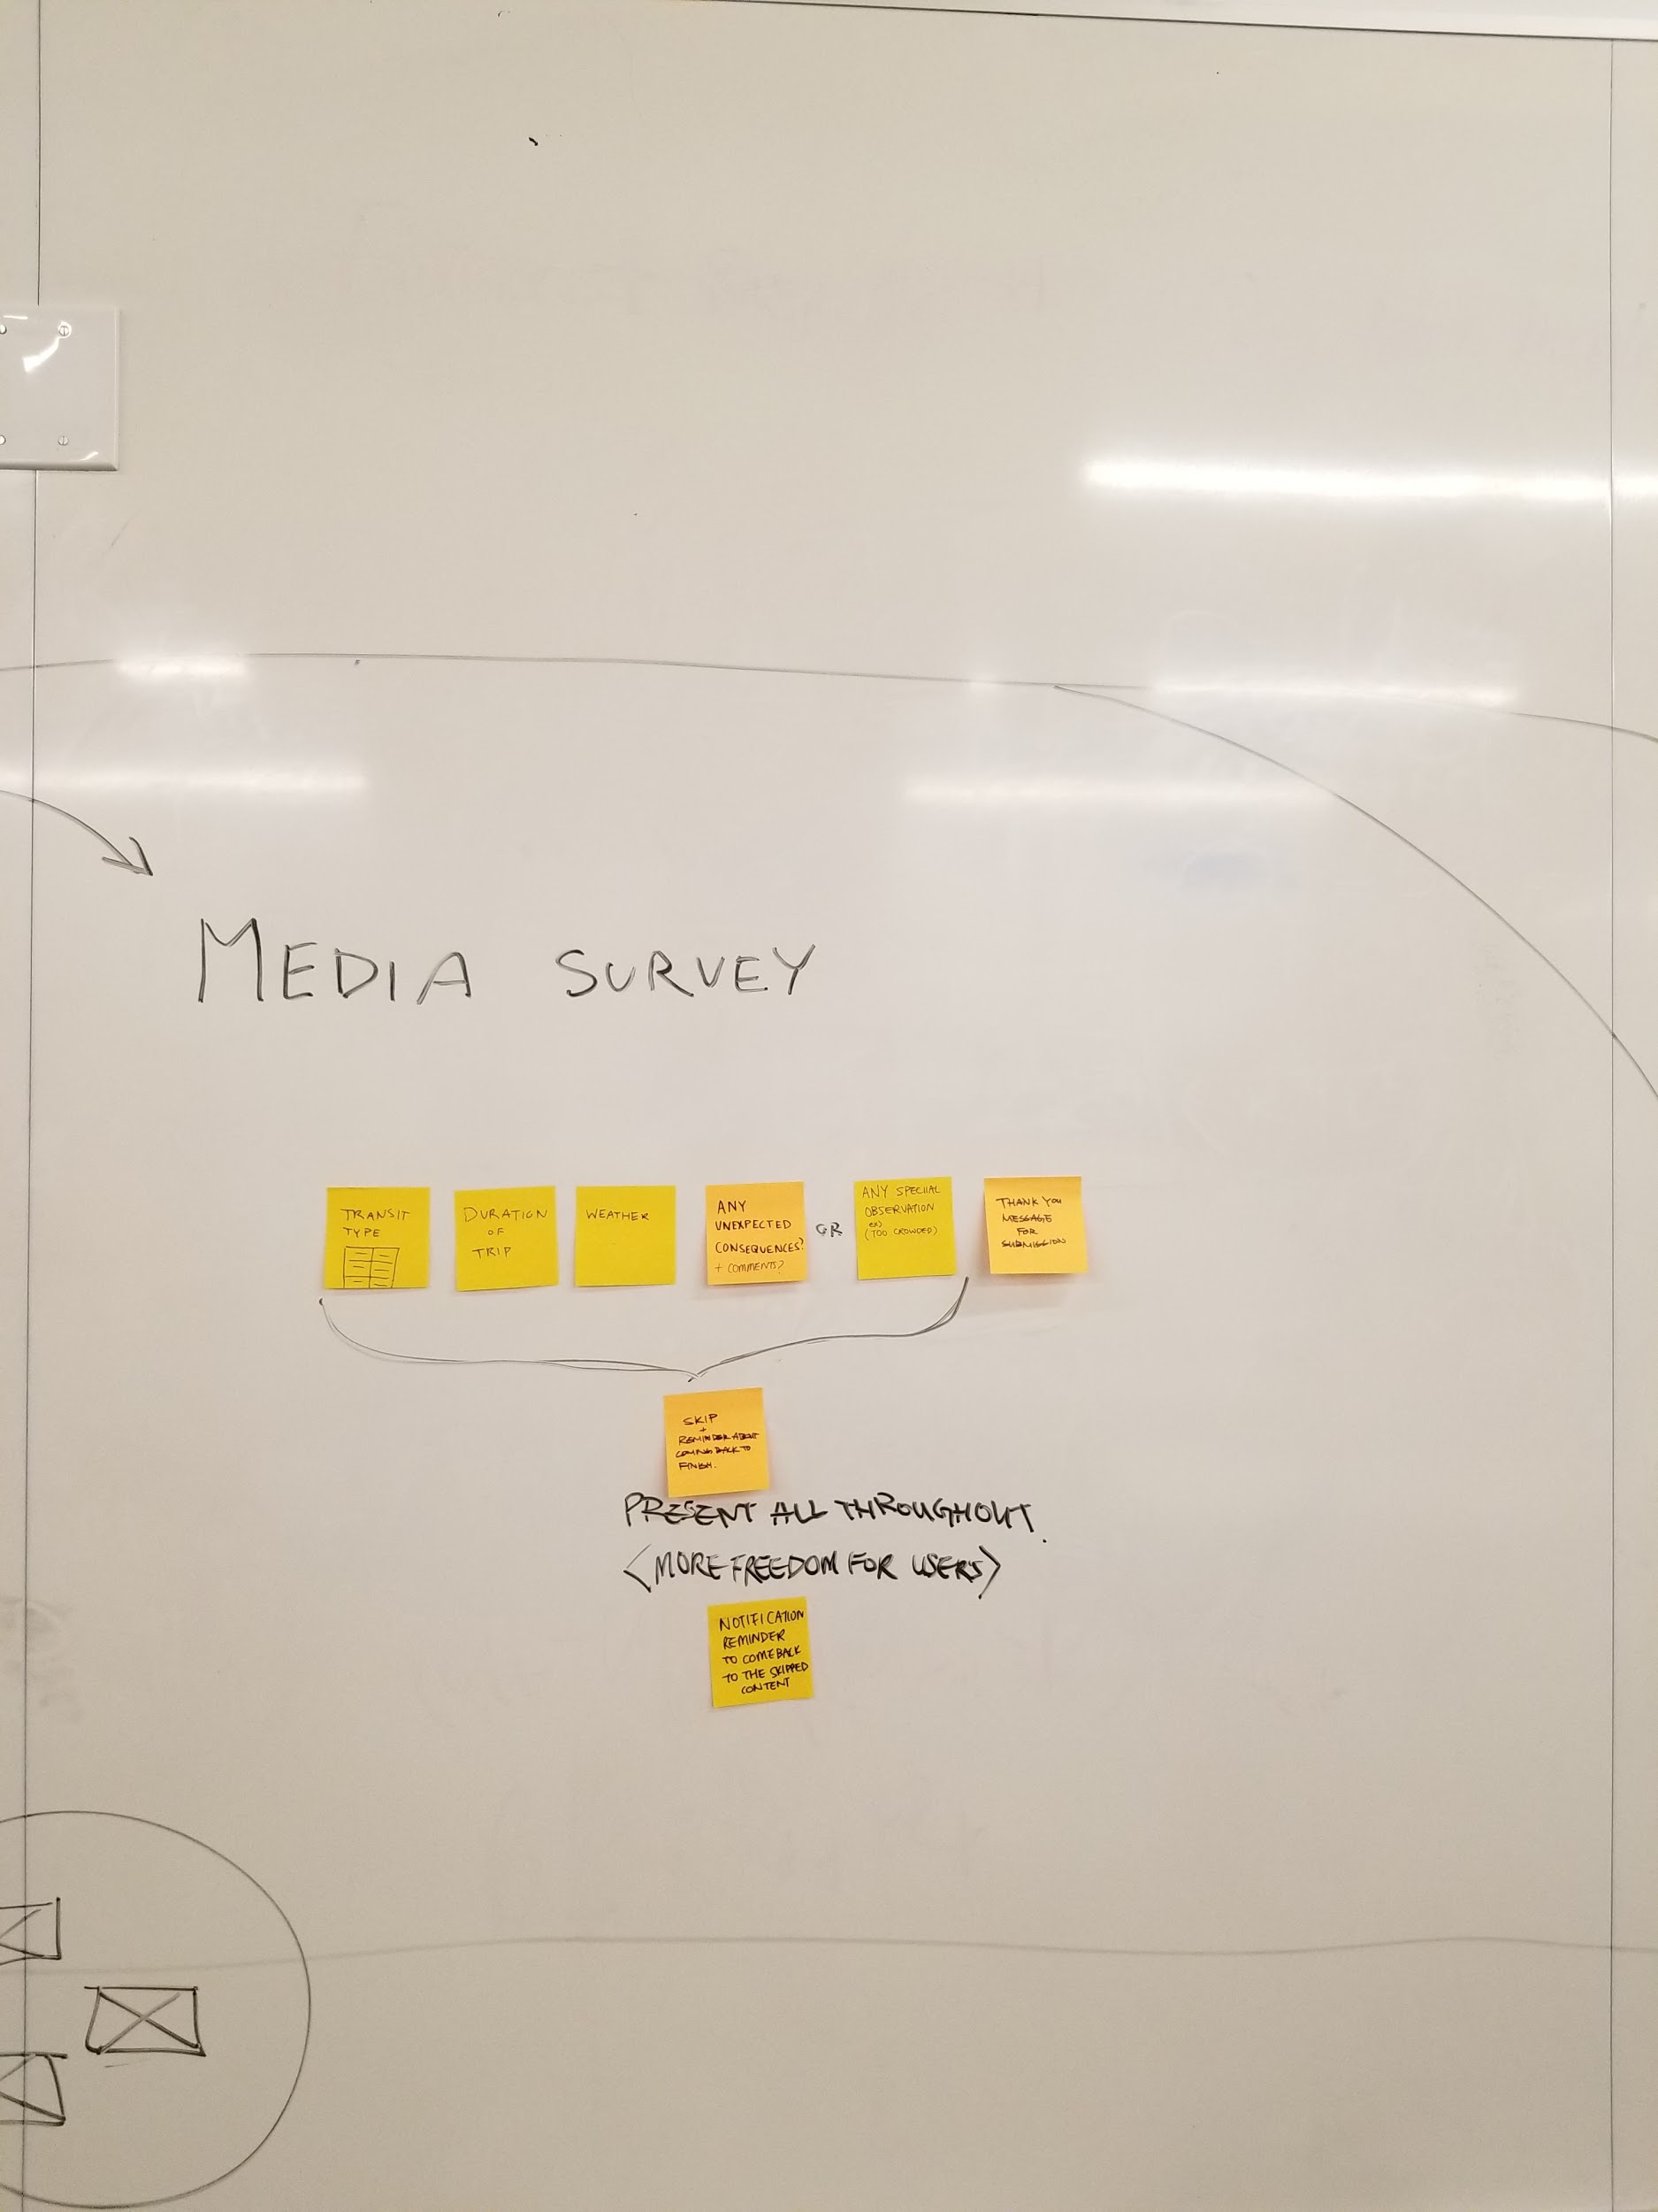
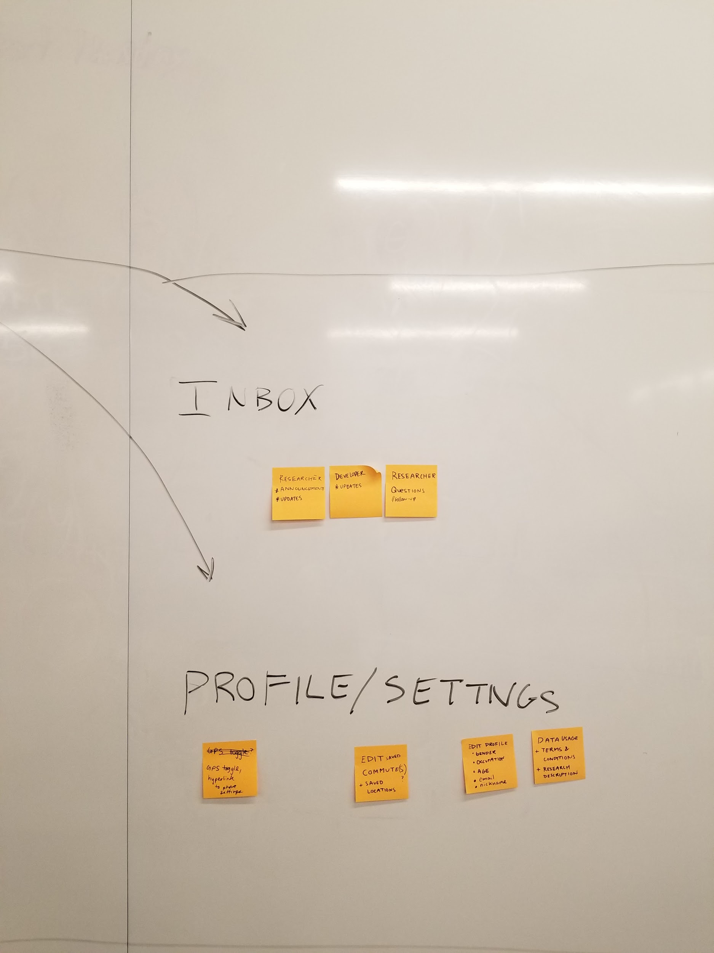
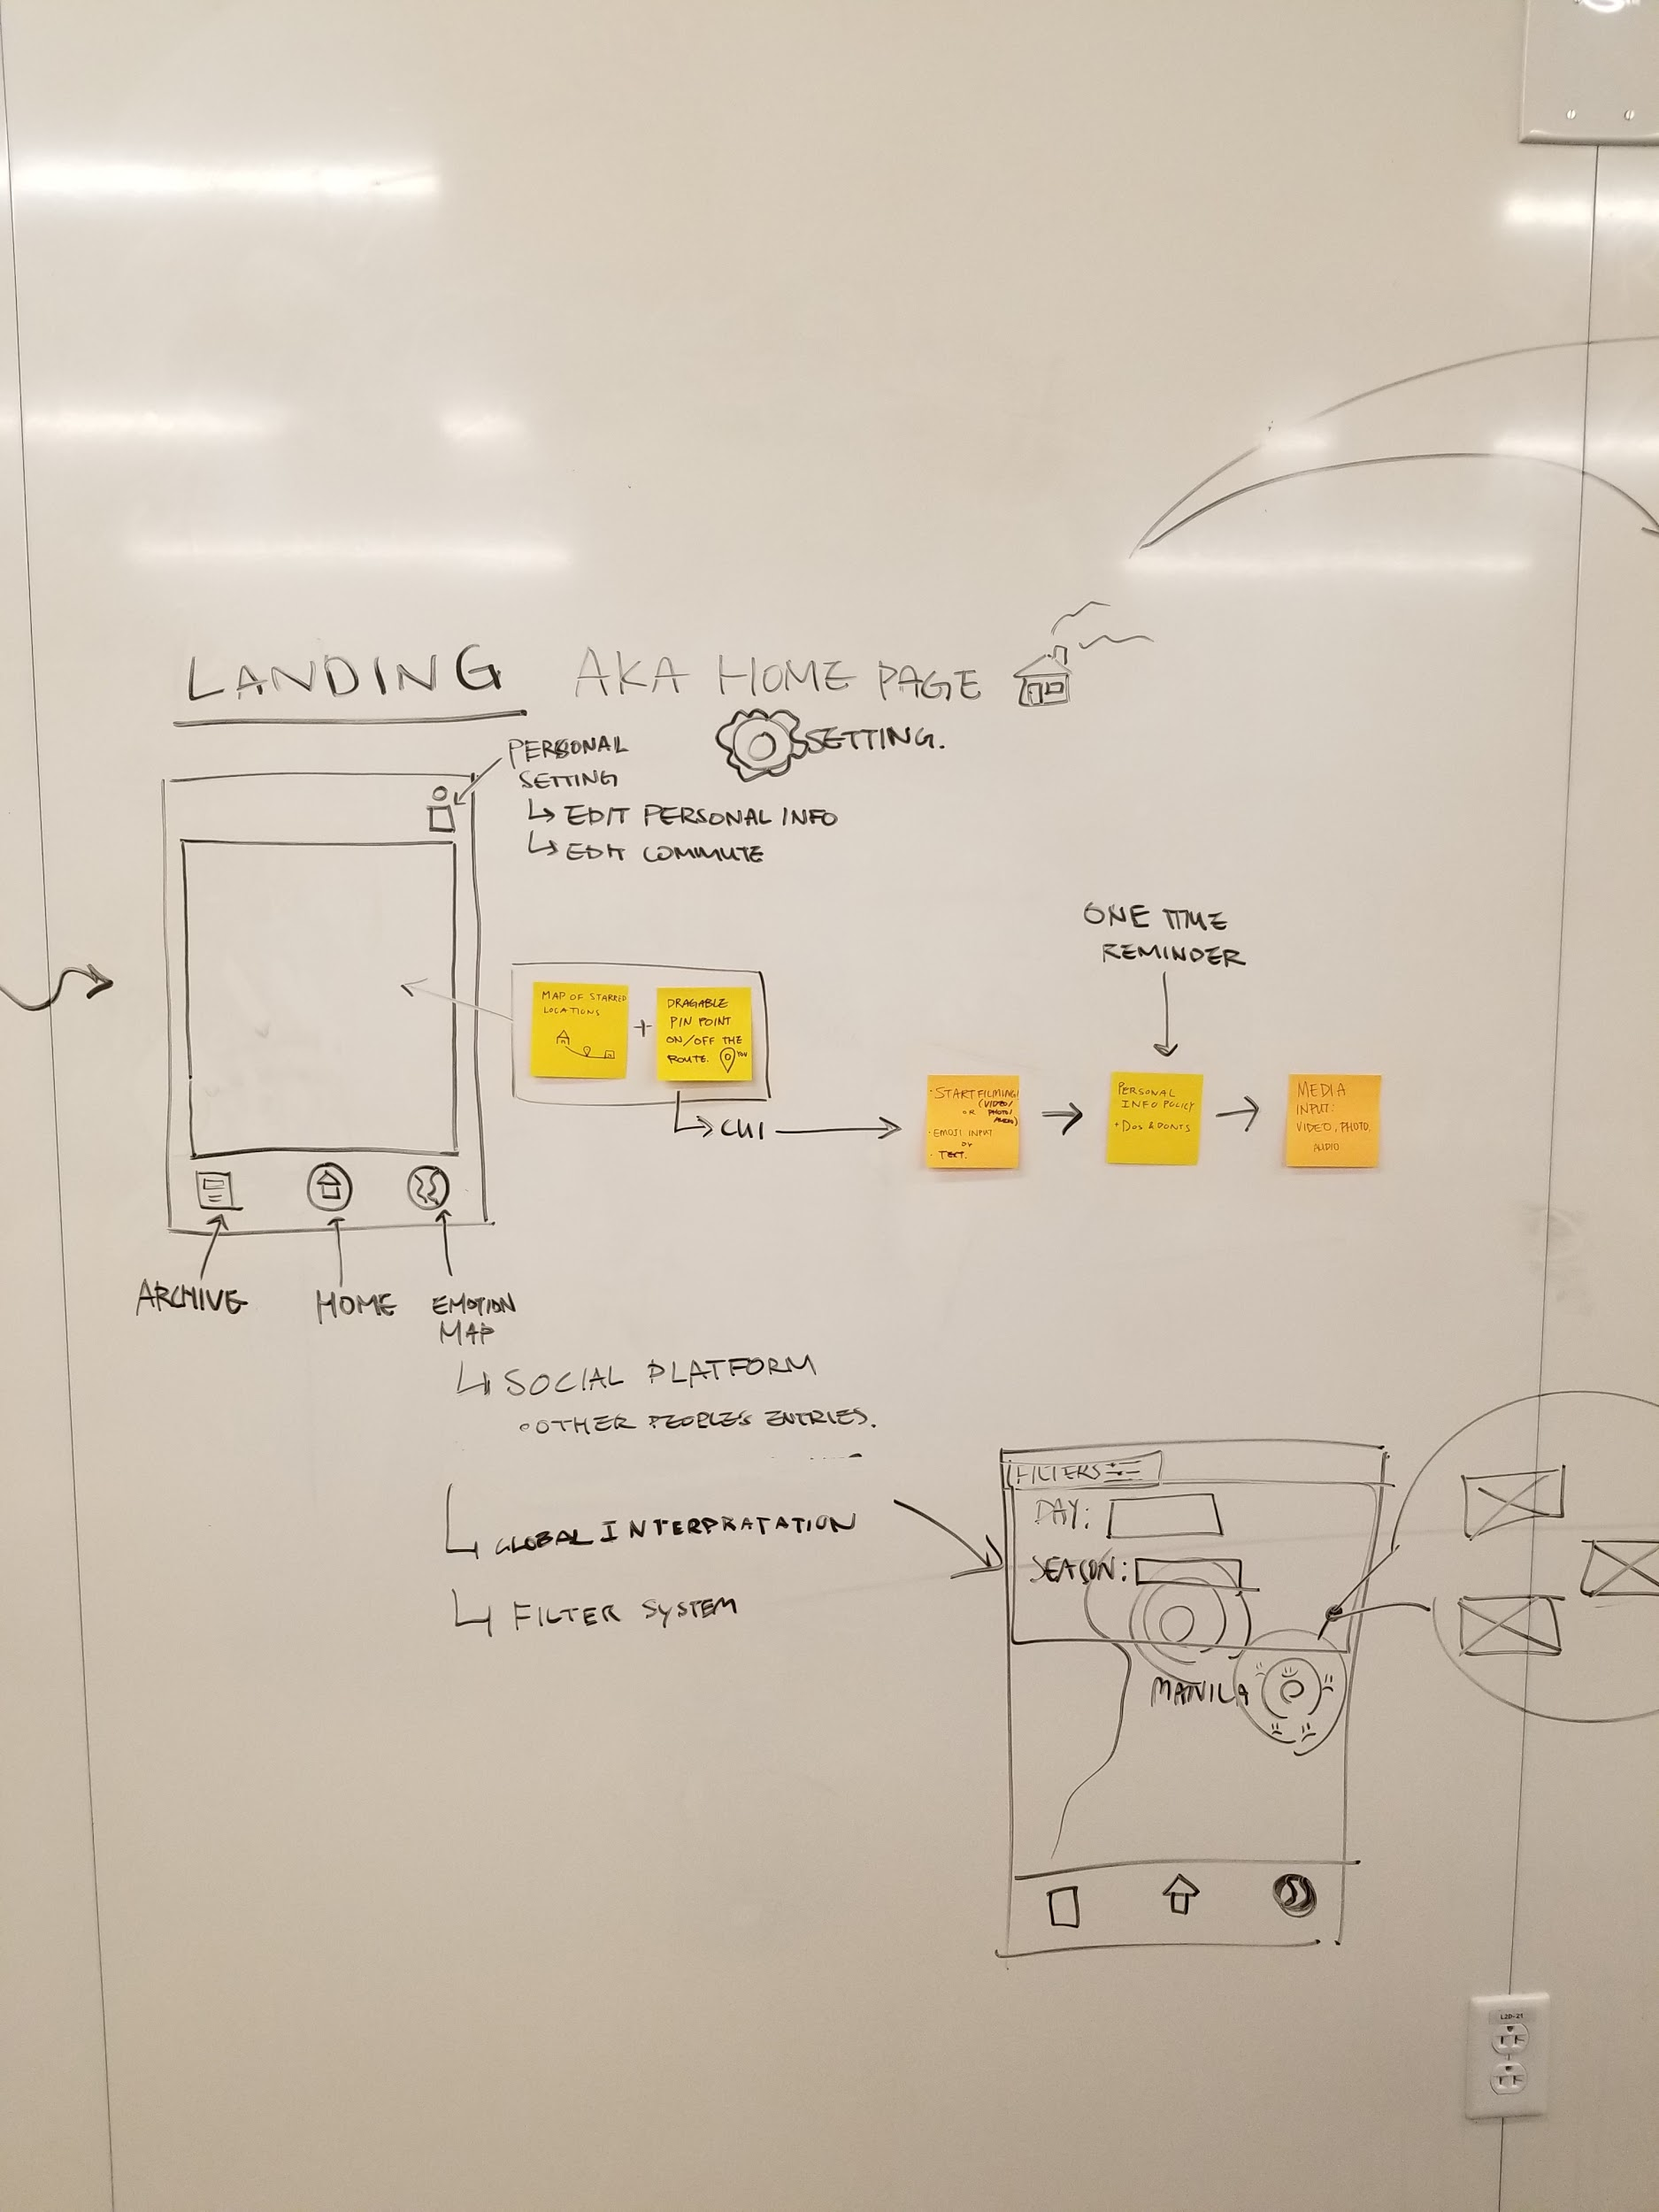
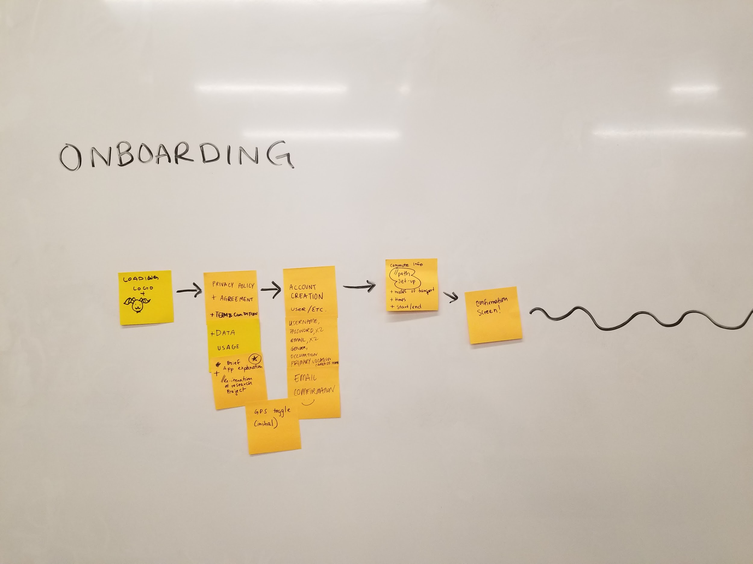
User Flow Map
Notes:
Junwoo

Slide 9
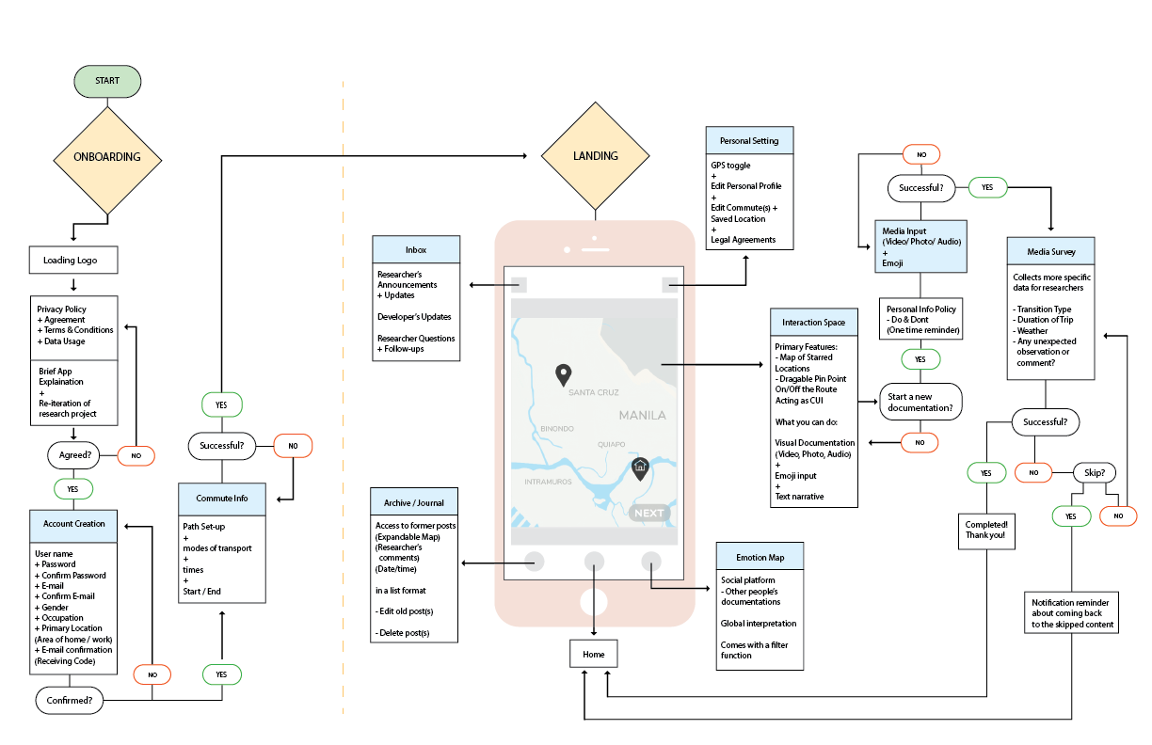

Slide 10
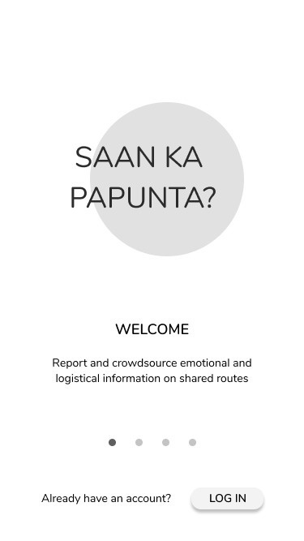
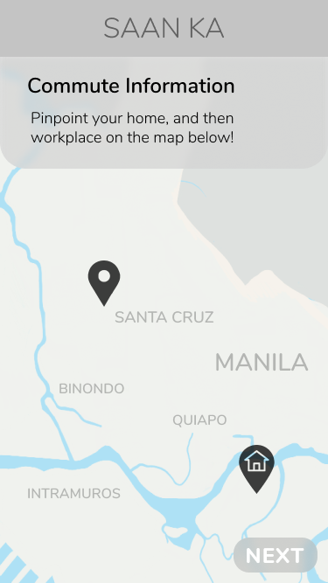
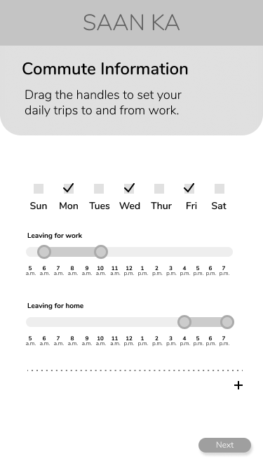
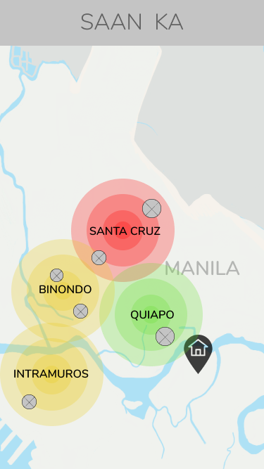
Low-fidelity Digital Prototyping
Notes:
Isa
So we used the feedback we received from Noah on our paper prototype, in addition to our steady research from the lit review in order to refine the low-fidelity digital version of our prototype.
In this version we have married several features he received quite positively, but most importantly integrated a dynamic system for posting documentation, allowing users to post as much or as little content as they want in addition to allowing them to return to content submission at a later point.
At the moment the mock-ups consist of the following (not all of which are pictured on the slide):
a set of onboarding screens
The homepage (from which you can submit content)
Content submission pages (the various pages relating to the steps of submitting the documentation of your commute experience)
Inbox (for interaction between researchers and )
Archive (wherein volunteers could go back and edit old posts, up to a certain age, and perhaps delete old posts as well?)
Settings (where GPS preferences, or custom preset transit paths, and the like could be edited)
Emotion Map (A page which provides a data visualization based on the documentation of all users - anonymously - based on the most potent emotions in certain areas which can filtered by date, time of day, etc.) and a way of giving back and showing users that all of the information they are inputting isn’t just going into some black hole;
// in other words it’s an idea for providing incentive for these research participants
We plan to mock-up the researcher’s end of the interface as well in due time once we receive feedback from Noah answering the questions we have revolving around that.
We plan to use the low-fidelity digital version alongside a usability script as we begin our user testing sessions this Wednesday.

Slide 11
Future Plan
Feedback with Noah
User testing
Hi-fi prototyping
Notes:
Julie
We plan on receiving feedback from Noah regarding our low-fidelity prototype this coming week
We plan on conducting user testing this week and hope to have the sessions finished by the weekend
We plan on mocking up the hi-fidelty prototypes in the following week and will continue to iterate on that using the knowledge we glean from the various testing sessions and research papers we have been consulting through the span of this project

